Slide 1

Internet Of things
Lecturer: Reza Arjmandi
Summer 2016
Preface:
In this chapter, you will learn how your Raspberry Pi can participate in the Internet of Things in various ways.

Slide 2
Measuring the Raspberry Pi CPU Temperature
You want to know just how hot your Raspberry Pi’s CPU is getting.
Use the os library to access the temperature sensor built into the Broadcom chip.
import os, time
while True:
dev = os.popen('/opt/vc/bin/vcgencmd measure_temp')
cpu_temp = dev.read()
print(cpu_temp)
time.sleep(1)
When you run this program, it will report the temperature. Note that the message printed is actually a string with temp= before the temperature and 'C after it.
$ python cpu_temp.py
temp=33.6'C
temp=33.6'C

Slide 3
Measuring the Raspberry Pi CPU Temperature
If you want the temperature as a number rather than a string, you need to chop off the extra text and then convert the number to a float.
import os, time
while True:
dev = os.popen('/opt/vc/bin/vcgencmd measure_temp')
cpu_temp_s = dev.read()[5:-3] # top and tail string
cpu_temp = float(cpu_temp_s)
print(cpu_temp)
time.sleep(1)

Slide 4
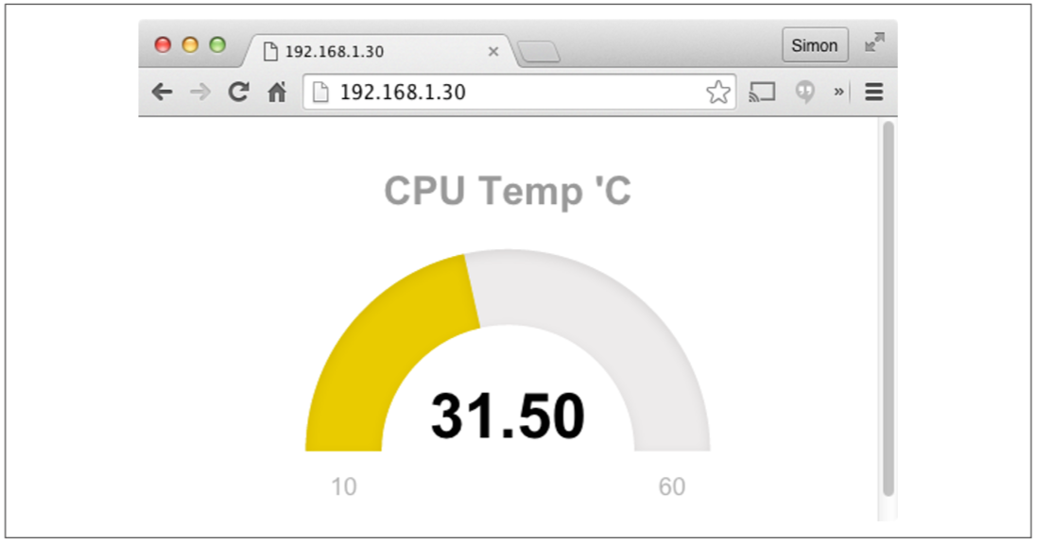
Displaying Sensor Readings on a Web Page
You want to display sensor readings from your Raspberry Pi on a web page that automatically updates.
Use the bottle web server and some fancy JavaScript to automatically update your display.

Slide 5
Displaying Sensor Readings on a Web Page
There are four files for this example, which are contained in the folder web_sensor:
web_sensor.py
Contains the Python code for the bottle server
main.html
Contains the web page that will be displayed in your browser
justgage.1.0.1.min.js
A third-party JavaScript library that displays the temperature meter
raphael.2.1.0.min.js
A library used by the justgage library
To run the program, change directory to web_sensor and then run the Python program using:
$ sudo python web_sensor.py
Then open a browser, either on the same Raspberry Pi or any computer on the same network as the Raspberry Pi, and enter the IP address of the Raspberry Pi into the browser’s address bar.

Slide 6
WebSensor.py Project
The main program (web_sensor.py) is actually quite concise:
import os, time
from bottle import route, run, template
def CpuTemp():
dev = os.popen('/opt/vc/bin/vcgencmd measure_temp')
temp = dev.read()[5:-3]
return temp
@route('/temp')
def Temp():
return CpuTemp()
@route('/')
def index():
return template('main.html')
@route('/raphael')
def index():
return template('raphael.2.1.0.min.js')

Slide 7
WebSensor.py Project
@route('/justgage')
def index():
return template('justgage.1.0.1.min.js')
run(host=‘0.0.0.0', port=80)
The function CpuTemp reads the temperature of the Raspberry Pi’s CPU, as described in Previous Recipe
Four routes are then defined for the bottle web server. The first (/temp) returns a string containing the CPU temperature in degrees C. The root route (/) returns the main HTML template for the page (main.html). The other two routes provide access to copies of the raphael and justgage JavaScript libraries.

Slide 8
main.html File
The file main.html mostly contains the JavaScript to render the user interface.
<html>
<head>
<script src="http://ajax.googleapis.com/ajax/libs/jquery/1.7.2/jquery.min.js" type="text/javascript" charset="utf-8"></script>
<script src="raphael"></script>
<script src="justgage"></script>
<script>
function callback(tempStr, status)
{
if (status == "success")
{
temp = parseFloat(tempStr).toFixed(2);
g.refresh(temp);
setTimeout(getReading, 1000);
}

Slide 9
main.html File
else
{
alert("There was a problem");
}
}
function getReading()
{
$.get('/temp', callback);
}
</script>
</head>
<body>
<div id="gauge" class="200x160px"></div>
<script>
var g = new JustGage({id: "gauge", value: 0, min: 10, max: 60,title: "CPU Temp 'C" })
getReading();
</script>
</body>
</html>

Slide 10
Displaying Sensor Readings on a Web Page
The JQuery, Raphael, and JustGage libraries are all imported (JQuery from https:// developers.google.com/speed/libraries/#jquery and the other two from local copies).
Getting a reading from the Raspberry Pi to the browser window is a two-stage process. First, the function getReading is called. This sends a web request with the route /temp to web_sensor.py and specifies a function called callback to be run when the web request completes. The callback function is then responsible for updating the JustGage display before setting a timeout to call getReading again after a second.

Slide 11
InternetSensor.py Project
The main program (InternetSensor.py) is actually quite concise:
import os, time
import urllib2
def CpuTemp():
dev = os.popen('/opt/vc/bin/vcgencmd measure_temp')
temp = dev.read()[5:-3]
return temp
while True:
temp = CpuTemp()
print("Raspberry Pi Temp: {}".format(temp))
urllib2.urlopen("https://dweet.io/dweet/for/RpiCourseDweet?temp={}".format(temp))
time.sleep(1)

Slide 12
index.html File
The file main.html mostly contains the JavaScript to render the user interface.
<html>
<head>
<script src="jquery.min.js" type="text/javascript" charset="utf-8"></script>
<script src="raphael.2.1.0.min.js"></script>
<script src="justgage.1.0.1.min.js"></script>
<script>
function callback(response, status){
if (status == "success") {
temp = parseFloat(response["with"]["0"]["content"]["temp"]).toFixed(2);
g.refresh(temp);
setTimeout(getReading, 1000);
}
else
{
alert("There was a problem");
}
}

Slide 13
main.html File
function getReading(){
$.get('https://dweet.io/get/dweets/for/RpiCourseDweet', callback);
}
</script>
</head>
<body>
<div id="gauge" class="200x160px"></div>
<script>
var g = new JustGage({
id: "gauge",
value: 0,
min: 10,
max: 60,
title: "Raspberry Pi Temp 'C"
});
getReading();
</script>
</body>
</html>

Slide 14
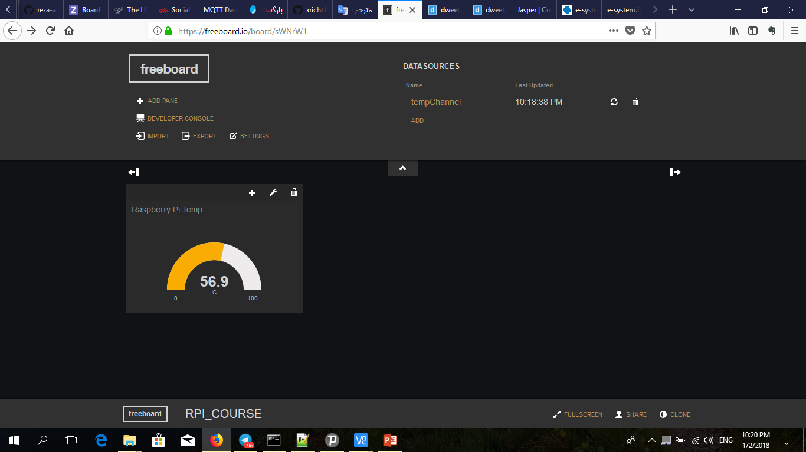
freeboard.io

Slide 15
Sending Email and Other Notifications with IFTTT
You want a flexible way for your Raspberrry Pi to send notifications by email, Facebook status, Twitter, or Slack.
This recipe is illustrated with an example that sends you an email when the CPU temperature of your Raspberry Pi exceeds a threshold.
You need to create an account with IFTTT before you can start using it, so visit www.ifttt.com and sign up.
Click on the Create a Recipe button. This will prompt you to first enter the IF part of the recipe and later the THAT part.
In this case, the IF THIS part (the trigger) is going to be the receipt of a web request from your Raspberry Pi, so click on THIS and then enter Maker into the search field to find the Maker channel. Select the Maker channel and when prompted to Choose a Trigger, select the option (Receive a Web Request). This will open the form shown in following figure.

Slide 16
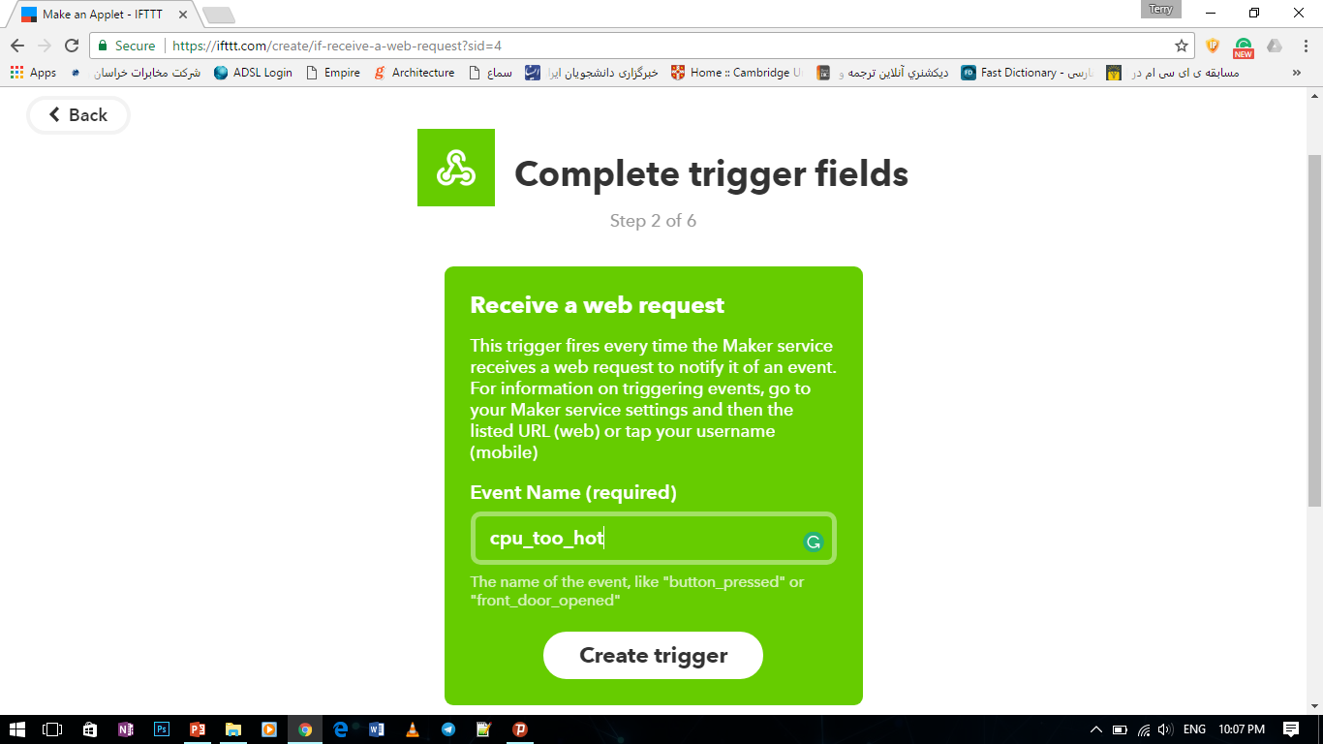
Sending Email and Other Notifications with IFTTT

Slide 17
Sending Email and Other Notifications with IFTTT
Enter the text cpu_too_hot into the Event Name field and click Create Trigger.
This will now move you to the THAT portion of the recipe, the action , and you will need to select an action channel. Here there are many options, but for this example you will use the Email channel, so type Email into the search field and then select the Email channel. You will see several email-related channels, including Gmail. Use the email channel, even if you are sending from a Gmail account.
Having selected the Email channel, select the action Send Me an Email, and the form shown in following figure will be displayed

Slide 18
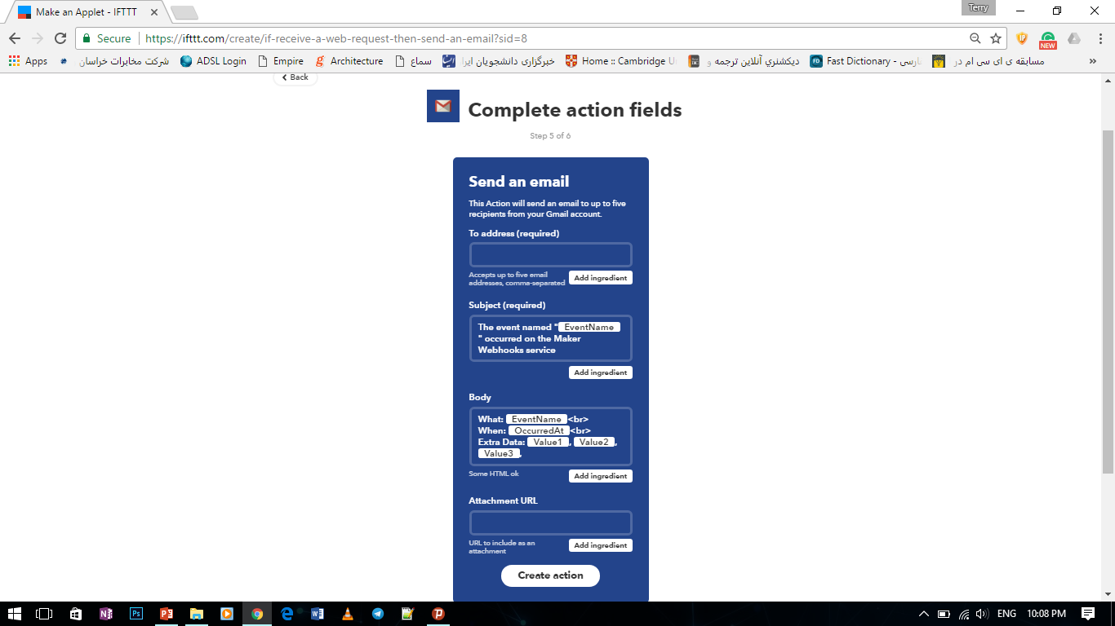
Sending Email and Other Notifications with IFTTT

Slide 19

Tor

Slide 20
Tor
Tor is free software for enabling anonymous communication. The name is derived from an acronym for the original software project name "The Onion Router". Tor directs Internet traffic through a free, worldwide, volunteer network consisting of more than seven thousand relays to conceal a user's location and usage from anyone conducting network surveillance or traffic analysis. Using Tor makes it more difficult for Internet activity to be traced back to the user: this includes "visits to Web sites, online posts, instant messages, and other communication forms". Tor's use is intended to protect the personal privacy of users, as well as their freedom and ability to conduct confidential communication by keeping their Internet activities from being monitored.
Install tor:
sudo apt-get install update
sudo apt-get install tor

Slide 21
EmailIfttt.py Project
The Python program to send the web request:
import time,os
MaxTemp = 37.0
EventName = 'cpu_hot'
BaseUrl = 'https://maker.ifttt.com/trigger/{}/with/key/{}'
Key = 'cxotxZpzCKtUnd3m7tkIk4'
def SendNotification(temp):
json = "'" + '{"value1" : "' + str(temp) + '"}' + "'"
completeUrl = BaseUrl.format(EventName, Key)
cmd = 'curl --socks5-hostname localhost:9050 -H "Content-Type:
application/json" -X POST -d {} {}'.format(json, completeUrl)
os.popen(cmd)
def CpuTemp():
dev = os.popen('/opt/vc/bin/vcgencmd measure_temp')
temp = dev.read()[5:-3]
return float(temp)

Slide 22
EmailIfttt.py Project
while True:
temp = CpuTemp()
print("CPU Temp(c) : {}".format(temp))
if temp > MaxTemp:
print("CPU TOO Hot!")
SendNotification(temp)
print("No more notification for : 5")
time.sleep(5)

Slide 23
Sending Email and Other Notifications with IFTTT
Before running the program, you will need to get an access key for the Maker Action channel by selecting Channels (at the top of the IFTTT web page), and then searching for Maker. Connect to the channel, and then you will see your key displayed near the bottom of the web page
Paste the key into previous program on the line that starts KEY= and then run the program using:
$ sudo python ifttt_cpu_temp.py
Most of the action for this program takes place in the send_notification email. This first constructs a URL including the key and request parameter value1 (containing the temperature) and then uses the Python urllib2 to send the web request to IFTTT.
The main loop continually checks the temperature against the MAX_TEMP, and if the CPU temperature exceeds MAX_TEMP, the web request is sent and a long sleep is started as specified by MIN_T_BETWEEN_WARNINGS to prevent your inbox from being flooded with notifications.

Slide 24
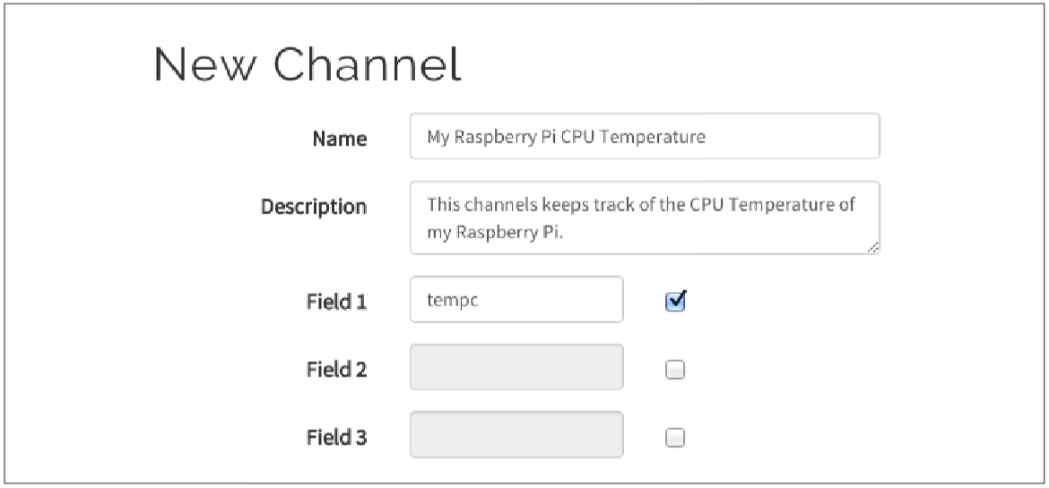
Sending Sensor Data to ThingSpeak
You want to log sensor data to ThingSpeak.
Log into ThingSpeak, and from the Channels drop-down, select My Channels. Now create a new channel by completing the top of the form as shown in following Figure

Slide 25
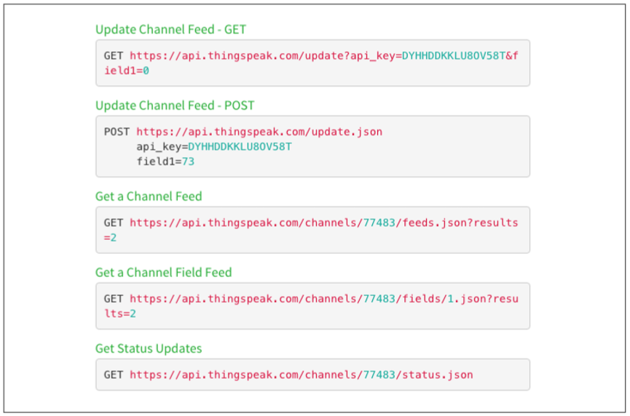
Sending Sensor Data to ThingSpeak
The rest of the form can be left blank. When you have finished editing, click Save Channel at the bottom of the page. Click on the Data Import/Export tab to find a summary of the web requests that you can use, customized to the channel you just created

Slide 26
ThingspeakData.py Project
To send data to the channel, a web request must be sent. The Python program:
import time, os, urllib, urllib2
DELAY = 15
BASEURL = 'https://api.thingspeak.com/update?api_key={}&field1={}'
KEY = 'SNDA3NE8T2I3A5W1'
def SendData(temp):
completeUrl = BASEURL.format(KEY, temp)
response = urllib2.urlopen(url=completeUrl)
print(response.read())
def CpuTemp():
dev = os.popen('/opt/vc/bin/vcgencmd measure_temp')
temperature = dev.read()[5:-3]
return temperature

Slide 27
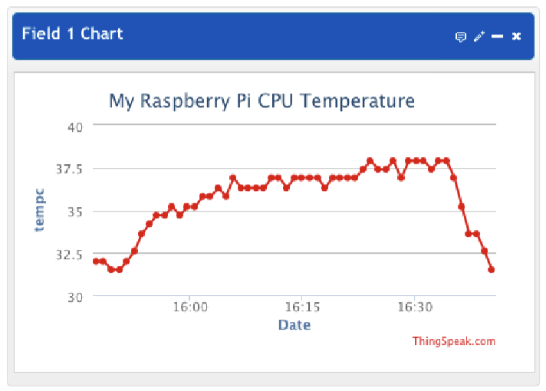
Sending Sensor Data to ThingSpeak
while True:
temp = CpuTemp()
print("CPU Temp (C): {}".format(temp))
SendData(temp)
time.sleep(DELAY)
Run the program. On the ThingSpeak channel page on the Private View tab, you should see a graph like:

Slide 28
Sending Email and Other Notifications with IFTTT
The variable PERIOD is used to determine the time interval between each sending of the temperature. This period is in seconds.
The send_data function constructs the web request, supplying the temperature in a parameter called field1.
If your data might be of public interest—say, accurate environmental readings—then you might want to make the channel public so that anyone can make use of it. This probably isn’t the case for your Pi’s CPU temperature.

Slide 29
Sending Tweets Using ThingSpeak
You want to automatically send tweets from your Raspberry Pi; for example, to irritate people by telling them the temperature of your CPU.
You could just use IFTTT and change the Action Channel to be Twitter. However, the ThingSpeak service is an alternative way of doing this.
Start by visiting https://thingspeak.com and signing up. Then select the ThingTweet action (Following figure). You will be prompted to log in to Twitter.

Slide 30
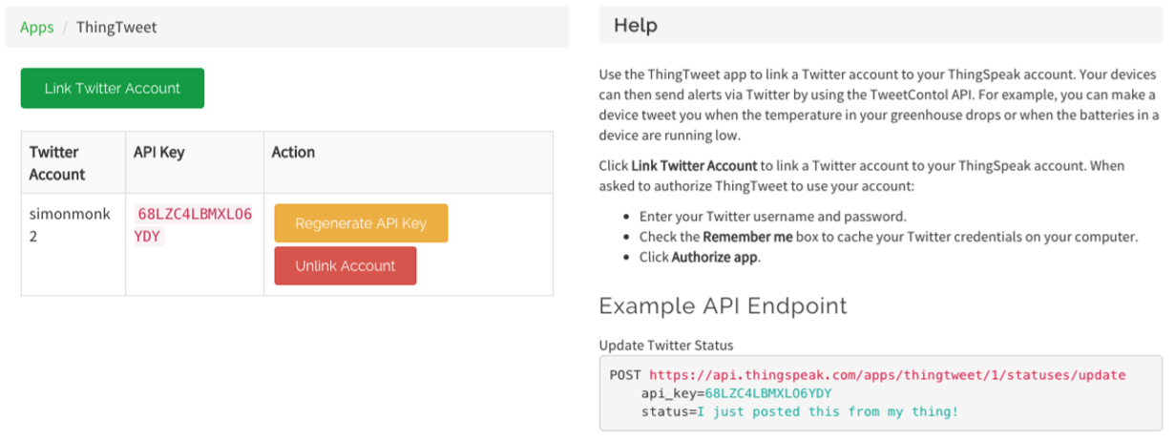
Sending Tweets Using ThingSpeak

Slide 31
SendTweet.py project
import time, os, urllib, urllib2
MAX_TEMP = 37.0
MIN_T_BETWEEN_WARNINGS = 60 # Minutes
BASE_URL = 'https://api.thingspeak.com/apps/thingtweet/1/statuses/update/' KEY = '68LZC4LBMXLO6YDY’
def send_notification(temp):
status = 'Raspberry Pi getting hot.
CPU temp=' + temp
data = urllib.urlencode({'api_key' : KEY, 'status': status})
response = urllib2.urlopen(url=BASE_URL, data=data)
print(response.read())

Slide 32
SendTweet.py project
while True:
temp = cpu_temp()
print("CPU Temp (C): " + str(temp))
if temp > MAX_TEMP:
print("CPU TOO HOT!")
send_notification(temp)
print("No more notifications for: " + str(MIN_T_BETWEEN_WARNINGS) + " mins")
time.sleep(MIN_T_BETWEEN_WARNINGS * 60)
time.sleep(1)

Slide 33
Sending Tweets Using ThingSpeak
For full documentation of the ThingSpeak service, see https://uk.mathworks.com/help/ thingspeak/.
You could just use IFTTT and change the Action Channel to be Twitter. However, the ThingSpeak service is an alternative way of doing this.
Start by visiting https://thingspeak.com and signing up. Then select the ThingTweet action (Following figure). You will be prompted to log in to Twitter.

Slide 34
Responding to Tweets Using Dweet and IFTTT
You want your Raspberry Pi to perform some action in response to a certain hashtag or mention in a tweet.
An efficient mechanism for monitoring tweets that does not rely on polling is to use IFTTT to spot tweets of interest and then send a web request to a service called Dweet that can push notifications to a Python program running on your Raspberry Pi (Following figure).
For example, you could flash an LED for 10 seconds every time there is a mention of your username on Twitter by using a Raspberry Squid or an LED attached to a breadboard.

Slide 35
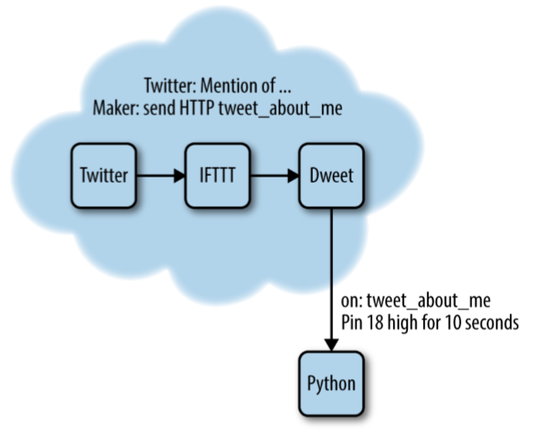
Responding to Tweets Using Dweet and IFTTT

Slide 36
Responding to Tweets Using Dweet and IFTTT
The first step is to log in to IFTTT and then create a new recipe. Choose an action channel of New Mention of You and then click Create Trigger. For the recipe’s action channel, select Webhooks and then select the action “Make a Web Request” and complete the fields as shown in Following figure.
The URL includes a request parameter with the ingredient of text. This will contain the body of the tweet. Although this will not be used other than to print it in the console, you might have the message displayed on an LCD screen for a more sophisticated project, so it is useful to know how to pass data from tweet to the Python program.
Then click Create Recipe to take the IFTTT recipe live.
The dweet.io web service operates rather like Twitter for IoT things. It has a web interface that allows you to both post and listen for dweets.

Slide 37
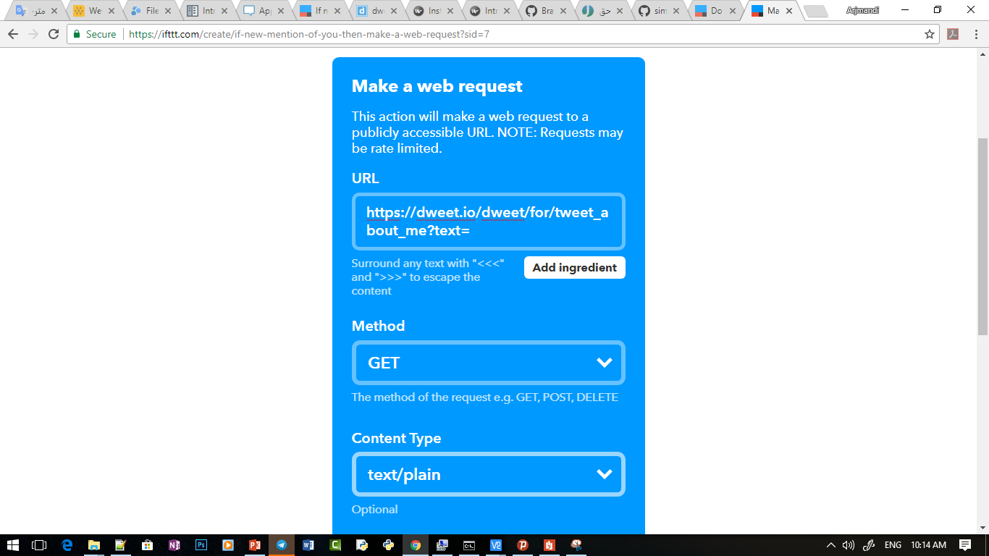
Responding to Tweets Using Dweet and IFTTT

Slide 38
Responding to Tweets Using Dweet and IFTTT
Dweet does not require an account or any login details to make use of it; you can just have one thing (IFTTT in this case) send a message to it and have another thing (your Raspberry Pi Python program) wait for notifications from it that something you are interested in has happened. In this case, the token that links the two is tweet_about_me. This is not very unique, and if several people are trying out this example from the book at the same time, then they will get each other’s messages. To avoid this, use a more unique token (say, by adding a random string of letters and numbers to the message).
To access Dweet from your Python program, the dweepy library needs to be installed, using the following commands:
git clone git://github.com/paddycarey/dweepy.git
cd dweepy
sudo python setup.py install

Slide 39
TwitterTrigger.py Project
import time
import dweepy
import RPi.GPIO as GPIO
KEY = 'tweet_about_me’
OUTPUT_PIN = 18
OUTPUT_DURATION = 10
GPIO.setmode(GPIO.BCM)
GPIO.setup(OUTPUT_PIN, GPIO.OUT)
while True:
try:
for dweet in dweepy.listen_for_dweets_from(KEY):
print('Tweet: ' + dweet['content']['text'])
GPIO.output(OUTPUT_PIN, True)
time.sleep(OUTPUT_DURATION)
GPIO.output(OUTPUT_PIN, False)
except Exception:
pass

Slide 40
Responding to Tweets Using Dweet and IFTTT
The program uses the listen_for_dweets_from method to leave an open connection to the dweet.io server, listening for any push messages from the server as a result of a dweet arriving from IFTTT in response to a tweet. The try/except block ensure that if there is any communication outage, the program will just start the listenning process again.

Slide 41


Contact us
www.e-system.ir
Info@e-system.ir

